Slide 1















Presented By – Shweta Barnwal
BANK LOAN ANALYSIS

Slide 2

BUSINESS PROBLEM

Slide 3

Business Problem
The bank aims to optimize loan portfolio performance by analysing customer data. Challenges include assessing creditworthiness, reducing defaults, and ensuring regulatory compliance. Strategic decision-making requires actionable insights from loan data analysis. Leveraging customer-centric KPIs, the bank seeks to enhance customer satisfaction, minimize risks, and drive portfolio growth.

Slide 4

OVERVIEW OF PROJECT

Slide 5
Overview of Project
Data Collection: Bank loan analytics begins with the collection of relevant data. This data can come from various sources.
Data Cleaning and Preparation: Once the data is collected, it needs to be cleaned and prepared for analysis. This involves tasks such as removing duplicates, correcting errors, handling missing values, and standardizing formats.
Descriptive Analytics: Descriptive analytics involves summarizing and interpreting the loan data to provide meaningful insights. This may include:
1. Summary Statistics
2. Data Visualization
In today’s financial landscape , banks play a pivotal role in facilitating Economic growth by providing loans for individuals and business . Our project focuses on analyzing the dynamics of bank loans for customers, a fundamental aspects of banking industry that directly impacts financial stability and prosperity.

Slide 6
OBJECTIVE

Slide 7
OBJECTIVE:
The objective was to provide insights into key loan-related metrics and their changes over time, aiding data-driven decision-making, tracking loan portfolio health, and identifying trends for lending strategy.
Utilize tools like Excel, Power BI, Tableau, and SQL to thoroughly cover all five Key Performance Indicators (KPIs) in the report, resulting in detailed analysis.
Finding relevant connections among the table so that when joined together they can show even better insights that they alone cannot present.
Identify appropriate visualization methods to effectively present the transformed data, ensuring clarity and accessibility
Obtain deeper insights beyond raw data by aggregating and calculating information, uncovering hidden patterns and trends

Slide 8

DATASET DESCRIPTION

Slide 9

DATASET DESCRIPTION
We have two datasets-
(1) Finance_1.xlsx
(2) Finance_2.xlsx.
Our aim is to extract actionable insights to address pertinent business problems.
Finance_1.xlsx and Finance_2.xlsx.
Combined size: Over 39k records each.
These datasets provides customers loan information, ID, Member_ID, Loan_Amnt Term, Int Rate, Grade, Sub-Grade, Home Ownership, Annual_Inc, Verification_Status, Issued_Month, Issued_Year, Loan_Status, Purpose, Addr_State, Revol_Bal, Total_Payment, Recoveries, Last_Pymnt_D, Last_Pymnt_Amnt, Last_Credit_Pull_D etc.
Finance 1
Finance 2
Merged 1

Slide 10
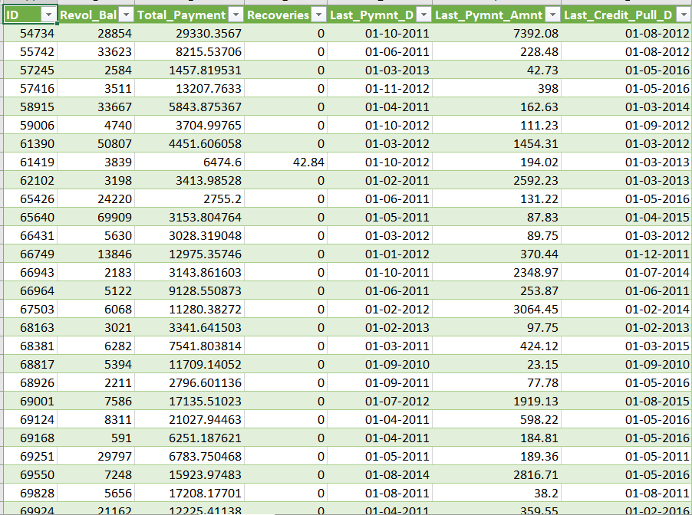
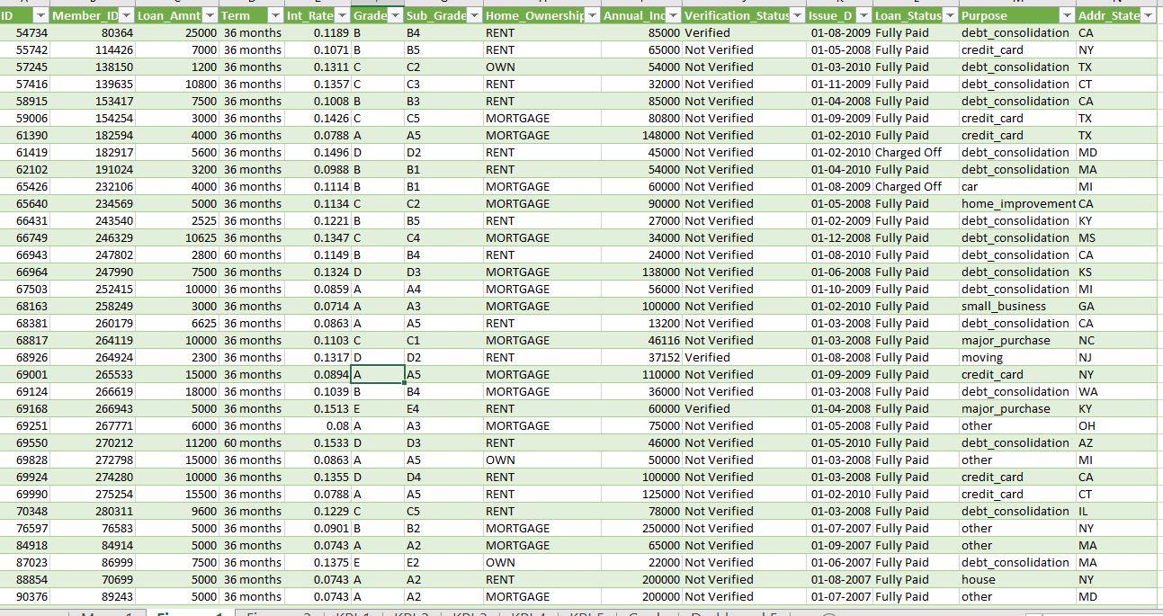
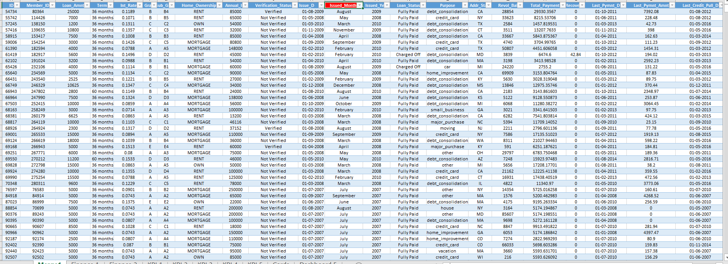
Finance 1
Finance 2
Merge
Merge

Slide 11

KPI 1

Slide 12
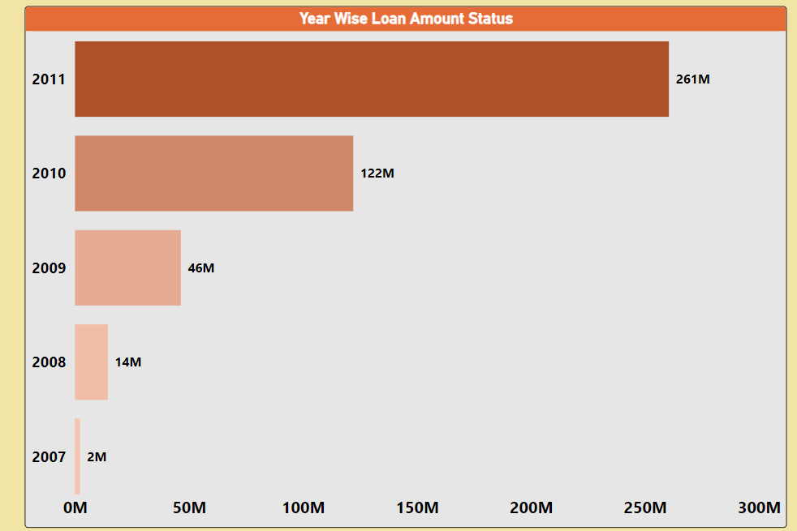

Slide 13
Year-wise Loan Amount Stats:
The analysis of year-wise loan amounts reveals evolving trends, indicating periods of increased or decreased lending activity. This insight aids in understanding the bank's historical performance and facilitates strategic planning for future loan disbursements.
Insight:
﻿First of it seems like the Total amount of loans has been increasing year by year.
Lowest Loan Amount:- In 2007 it was 2 M. Then it kept growing.
Highest Loan Amount:- By 2011 it reached a whooping 261 M.
Sum of Total Loan Amount:- 445.6 M.
﻿2011 accounted for 58.46% of the Sum of Loan Amount.
The data tells us that there's been a trend of increasing loan activity.

Slide 14

KPI 2

Slide 15
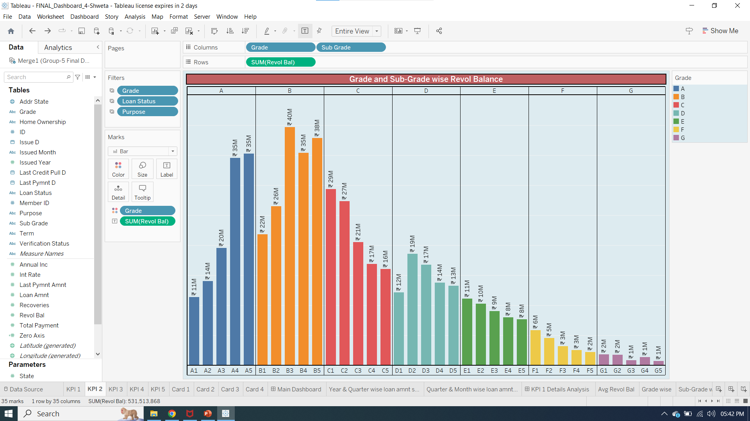

Slide 16
Grade and Sub-grade Wise Revolving Balance
Examining revolving balances by loan grade and sub-grade offers a nuanced view of credit risk and borrower behavior. Identifying variations helps in tailoring risk management strategies, ensuring a balanced portfolio and minimizing potential defaults.
Insights:
The data is divided into categories A to G each with Sub-Grades A1 to A5, B1 to B5 etc.
Grade-wise Revolving Bal:- At 161M (161308549) B grade had the highest Sum of Revolving Bal and was higher than G, which had the lowest Sum of Revolving Bal at 6M (6462726).
Sub-grade wise Revolving Balance:- At 40M (39723554) Sub-category B3 had the highest Revolving Bal & At 1 M (701515) Sub-category G5 had the lowest Revolving Bal.
Category A,B & C have the most money borrowed while Category G has least.
The data tells us that Category B has highest variability in sub-category indicating potential financial Risk & category D,E & F have lower variability suggesting more stable financial situations. ﻿﻿﻿ ﻿﻿ ﻿

Slide 17
KPI 3

Slide 18
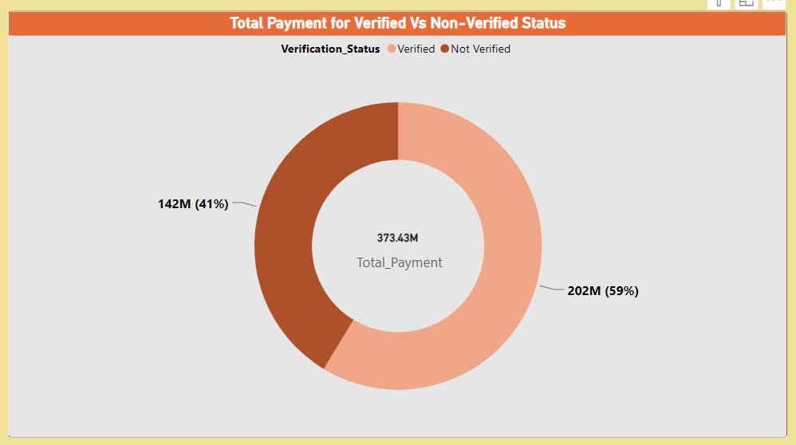

Slide 19
Total Payment for Verified Status Vs Total Payment for Non Verified Status:
Comparing total payments between verified and non-verified statuses provides insights into the payment behavior of customers based on their credibility. This understanding is essential for refining risk assessment models and optimizing customer relationship management practices.
Insights:
Sum of Loan Amount for Verified 202M (202236600) was higher than Not Verified 142M (142499050).﻿
﻿Verified accounts are 59% of Sum of Loan Amount.﻿﻿
Not verified accounts are 41% of the Sum of Loan Amount.
By the analysis we predicted that we need to take action against the not verified account because these will create loss. ﻿﻿﻿ ﻿﻿ ﻿

Slide 20
KPI 4

Slide 21
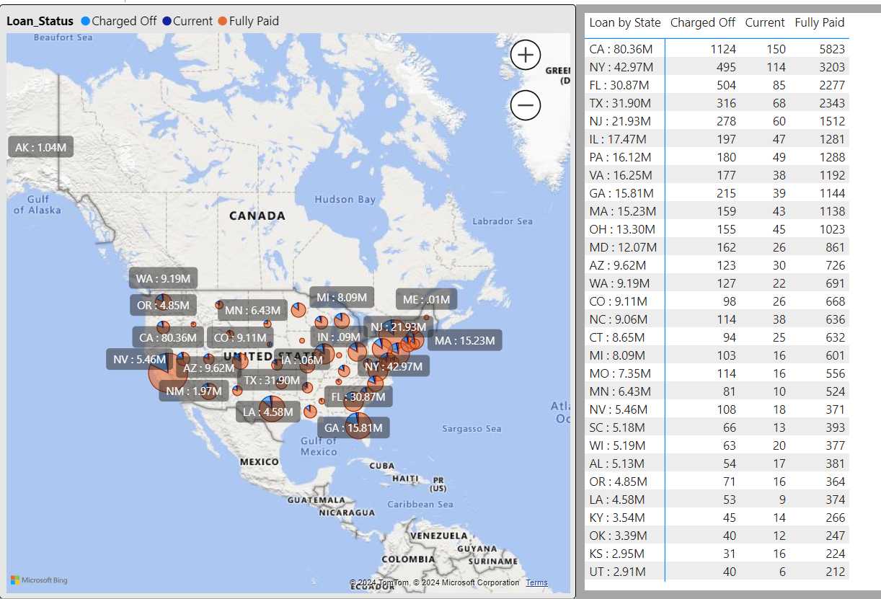

Slide 22
State-wise and Last_Credit_Pull_D Wise Loan Status
Analyzing loan status variations across different states and in relation to the last credit pull date offers geographical risk insights. This understanding enables strategic decisions on loan distribution, helping the bank tailor its approach to diverse markets.
Insights:
Fully Paid had the highest total Count of Last_Credit_Pull_D at 32,949, followed by Charged Off at 5626 and Current at 1140.﻿﻿
﻿﻿State with highest Loan Amount:- CA: 80.36M & had Most no. of Fully Paid loan status (5823) made up 14.66% of Count of Last_Credit_Pull_D.﻿﻿
﻿﻿﻿Fully Paid had the highest average Count of Last_Credit_Pull_D at 658.98, followed by Charged Off at 119.70 and Current at 26.51.﻿﻿
﻿﻿﻿﻿State with the lowest Loan Amount :- ﻿ME﻿ : .01M
By the analysis we predicted that need to act on the charged off loans. ﻿﻿﻿ ﻿﻿ ﻿

Slide 23
KPI 5

Slide 24
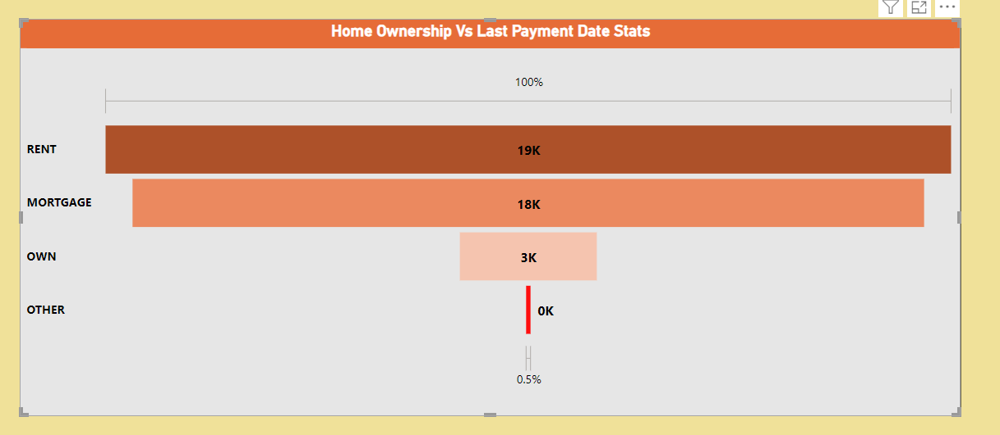

Slide 25
Home Ownership Vs. Last Payment Date Stats
Evaluating the relationship between home ownership and last payment dates provides valuable insights into the payment behavior of homeowners and renters. This analysis aids in designing targeted marketing strategies and optimizing portfolio management based on customer preferences.
Insights:
Total count of Last payment date is 40k across the various housing types.
Renters count: 19 k which highest among all the home ownerships.
Other count: only 98 which is the lowest among all the home ownerships.
Mortgage count : 18 k
Own count : 3K

Slide 26
DASHBOARD -
MS-EXCEL

Slide 27
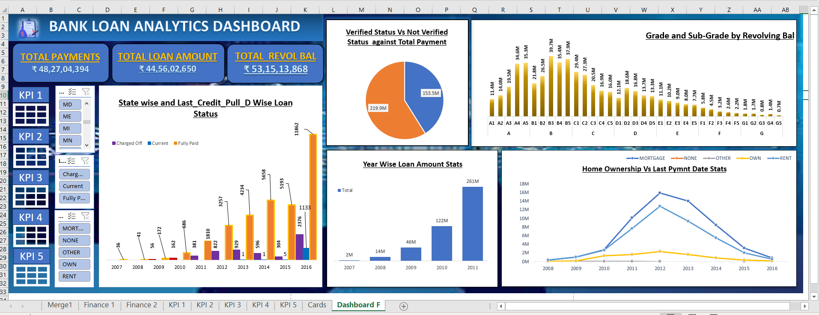

Slide 28
SQL QUERY

Slide 29
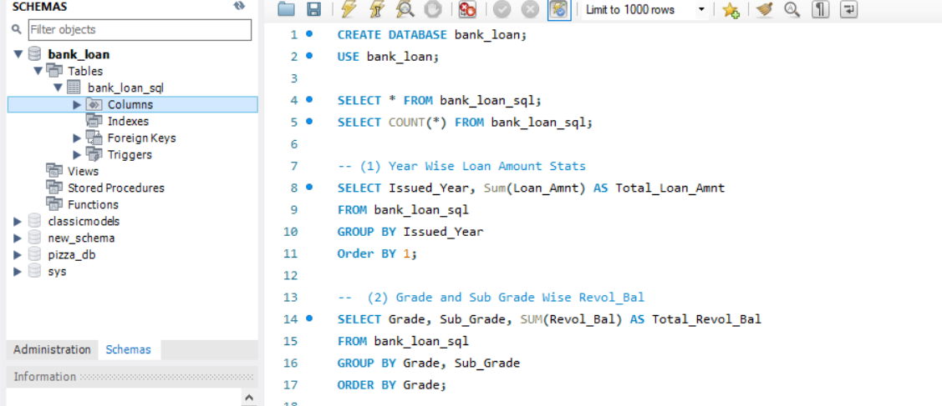
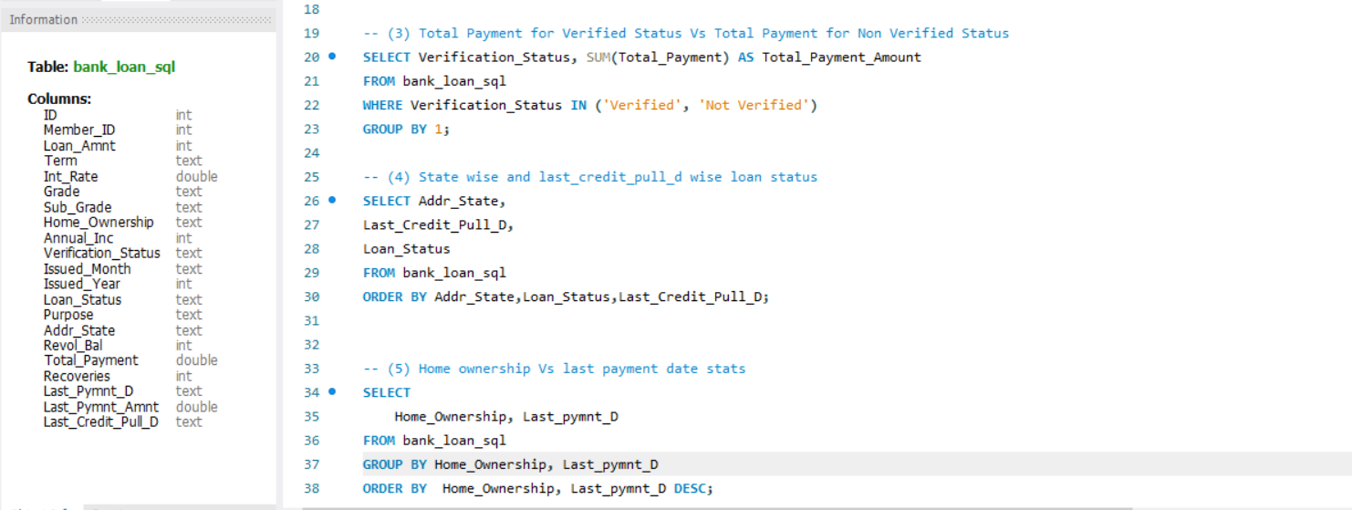

Slide 30
DASHBOARD -
TABLEAU

Slide 31
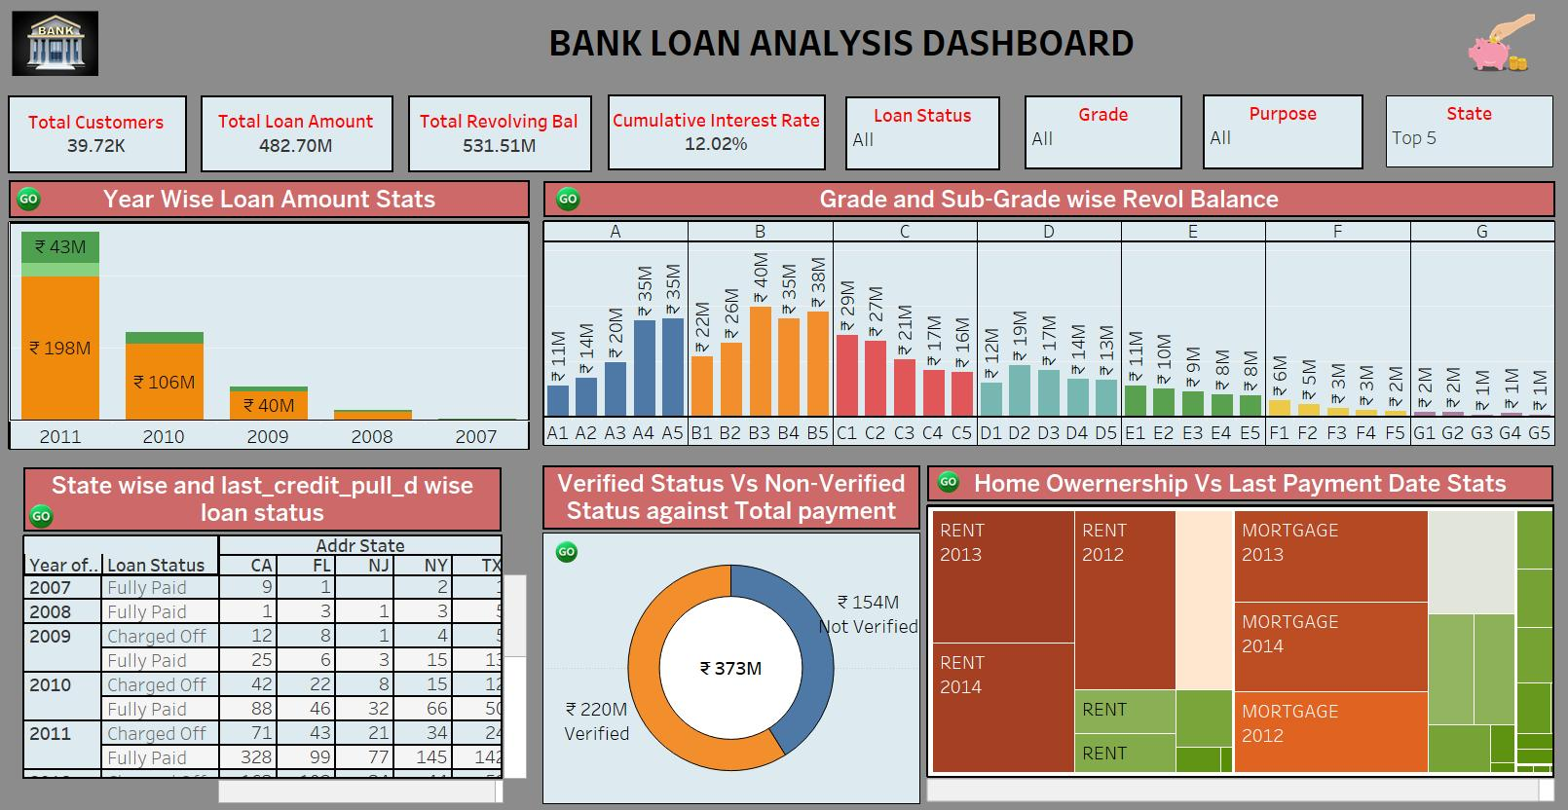

Slide 32
DASHBOARD -
POWERBI

Slide 33
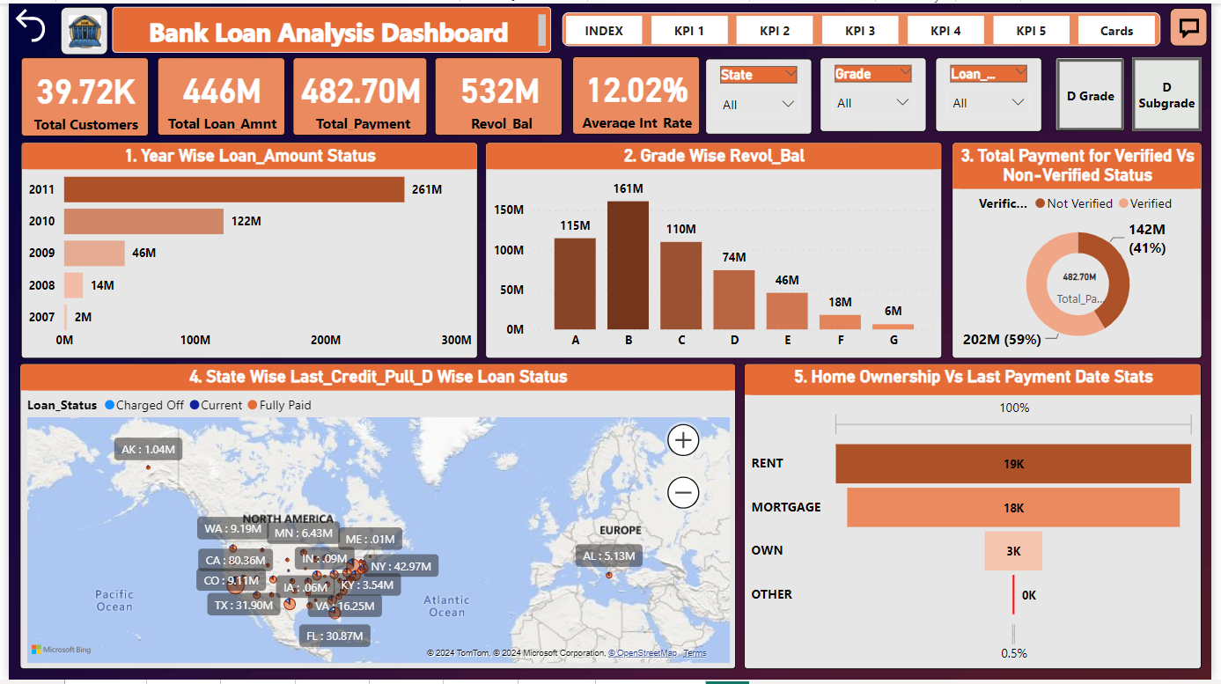

Slide 34
CONCLUSION

Slide 35
Conclusion
The Increase in the loan amount signifies a growing credit demand. Growing loan amounts indicate borrowers increased willingness to seek financing of various needs.
Following closely is the "Charged Off" category, indicating a substantial number of loans declared as losses.
The data tells us that Category B has the highest variability in sub-categories B3 indicating potential financial Risk & category D,E & F have lower variability suggesting more stable financial situations.
Need to take action against the not verified account. Because these will create loss. To avoid the loss the bank should verify all the accounts, this will help to maintain transparency and good customer relationship.
The data underscores the importance of verification in facilizing higher payment volumes and potentially enhancing the trust and security of financial transactions.
The data highlights the significance of mortgage loans in the housing market due to their higher loan amounts compared to other home ownership categories. Analysing the last payment date aids in assessing payment timeliness and potential repayment patterns within each home ownership category.

Slide 36

THANK YOU

